Slide 1

CIS5376 Machine Learning
Prof. Sam Lee
Team Members:
1.Abelardo Garcia
2.Sujan Pokharel
3.Ramyanth Nakshathram
4.Sai Lakshman Ethakatla
5.Rupadevi Raga
6.Sathya Priya
This Photo by Unknown author is licensed under CC BY-ND.

Slide 2

Agenda
1. Business scenario
2. Data description
3. Data transformation
4. Data Analysis
5. Machine Learning
6. Conclusion
This Photo by Unknown author is licensed under CC BY-SA-NC.

Slide 3

Business Scenario
- Yelp would like to find what makes up the positive review and predict if the accuracy of a restaurant would be positive or negative based on the reviews.
- Yelp would like to use the findings to recommend restaurants with positive reviews to customers
- Suggest the popular products of restaurants to the first-time customers based on the word cloud.

Slide 4
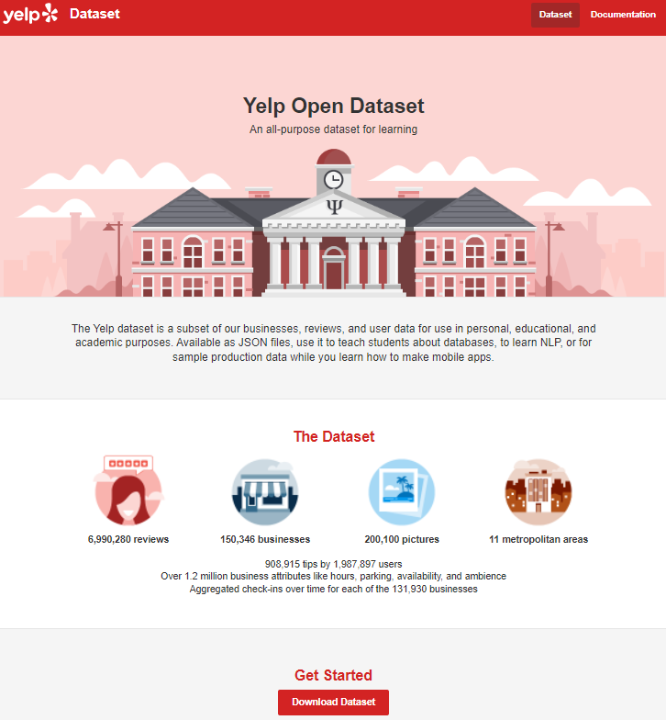
Data Description
●We collected the data by downloading the yelp dataset which can be found at this website: https://www.yelp.com/dataset

Slide 5
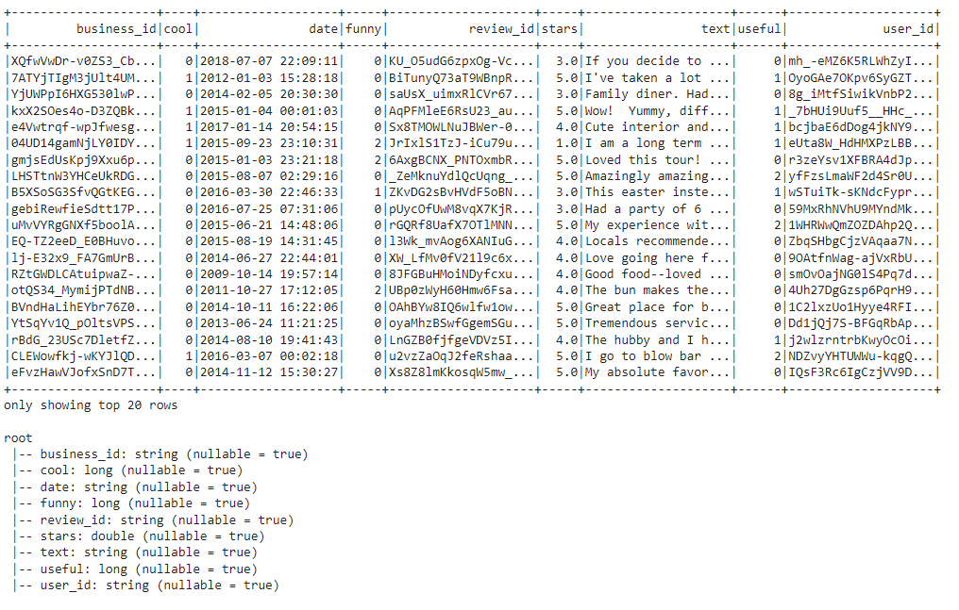
Data Description
Yelp business review dataset has 9 variables and the size of it is 4.98 GB

Slide 6

Data Transformation
Standard text preprocessing steps were taken to transform the data.
First step being feature selection where an optimal subset of attributes were selected to build the predictive model on.
The next step involved "cleaning" the text that would be analyzed for sentiment.
Steps involved in cleaning data --
1. Removing duplicates
2. Removing non-word characters
3. Stop word removal
4. Stemming
5. Bag of words
6. Matching based on a corpus of positive words to determine polarity.

Slide 7
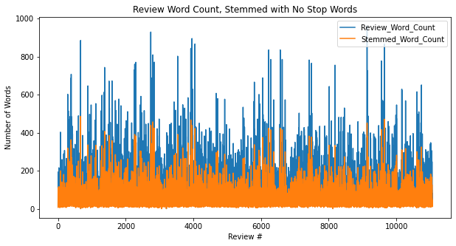
- Original Word Count (blue) vs Word Count after Stemming
- Significant difference of word count after stemming

Slide 8

Data Analysis
- Through Exploratory Analysis on the dataset, we can gather that most reviews on yelp are generally positive.

Slide 9
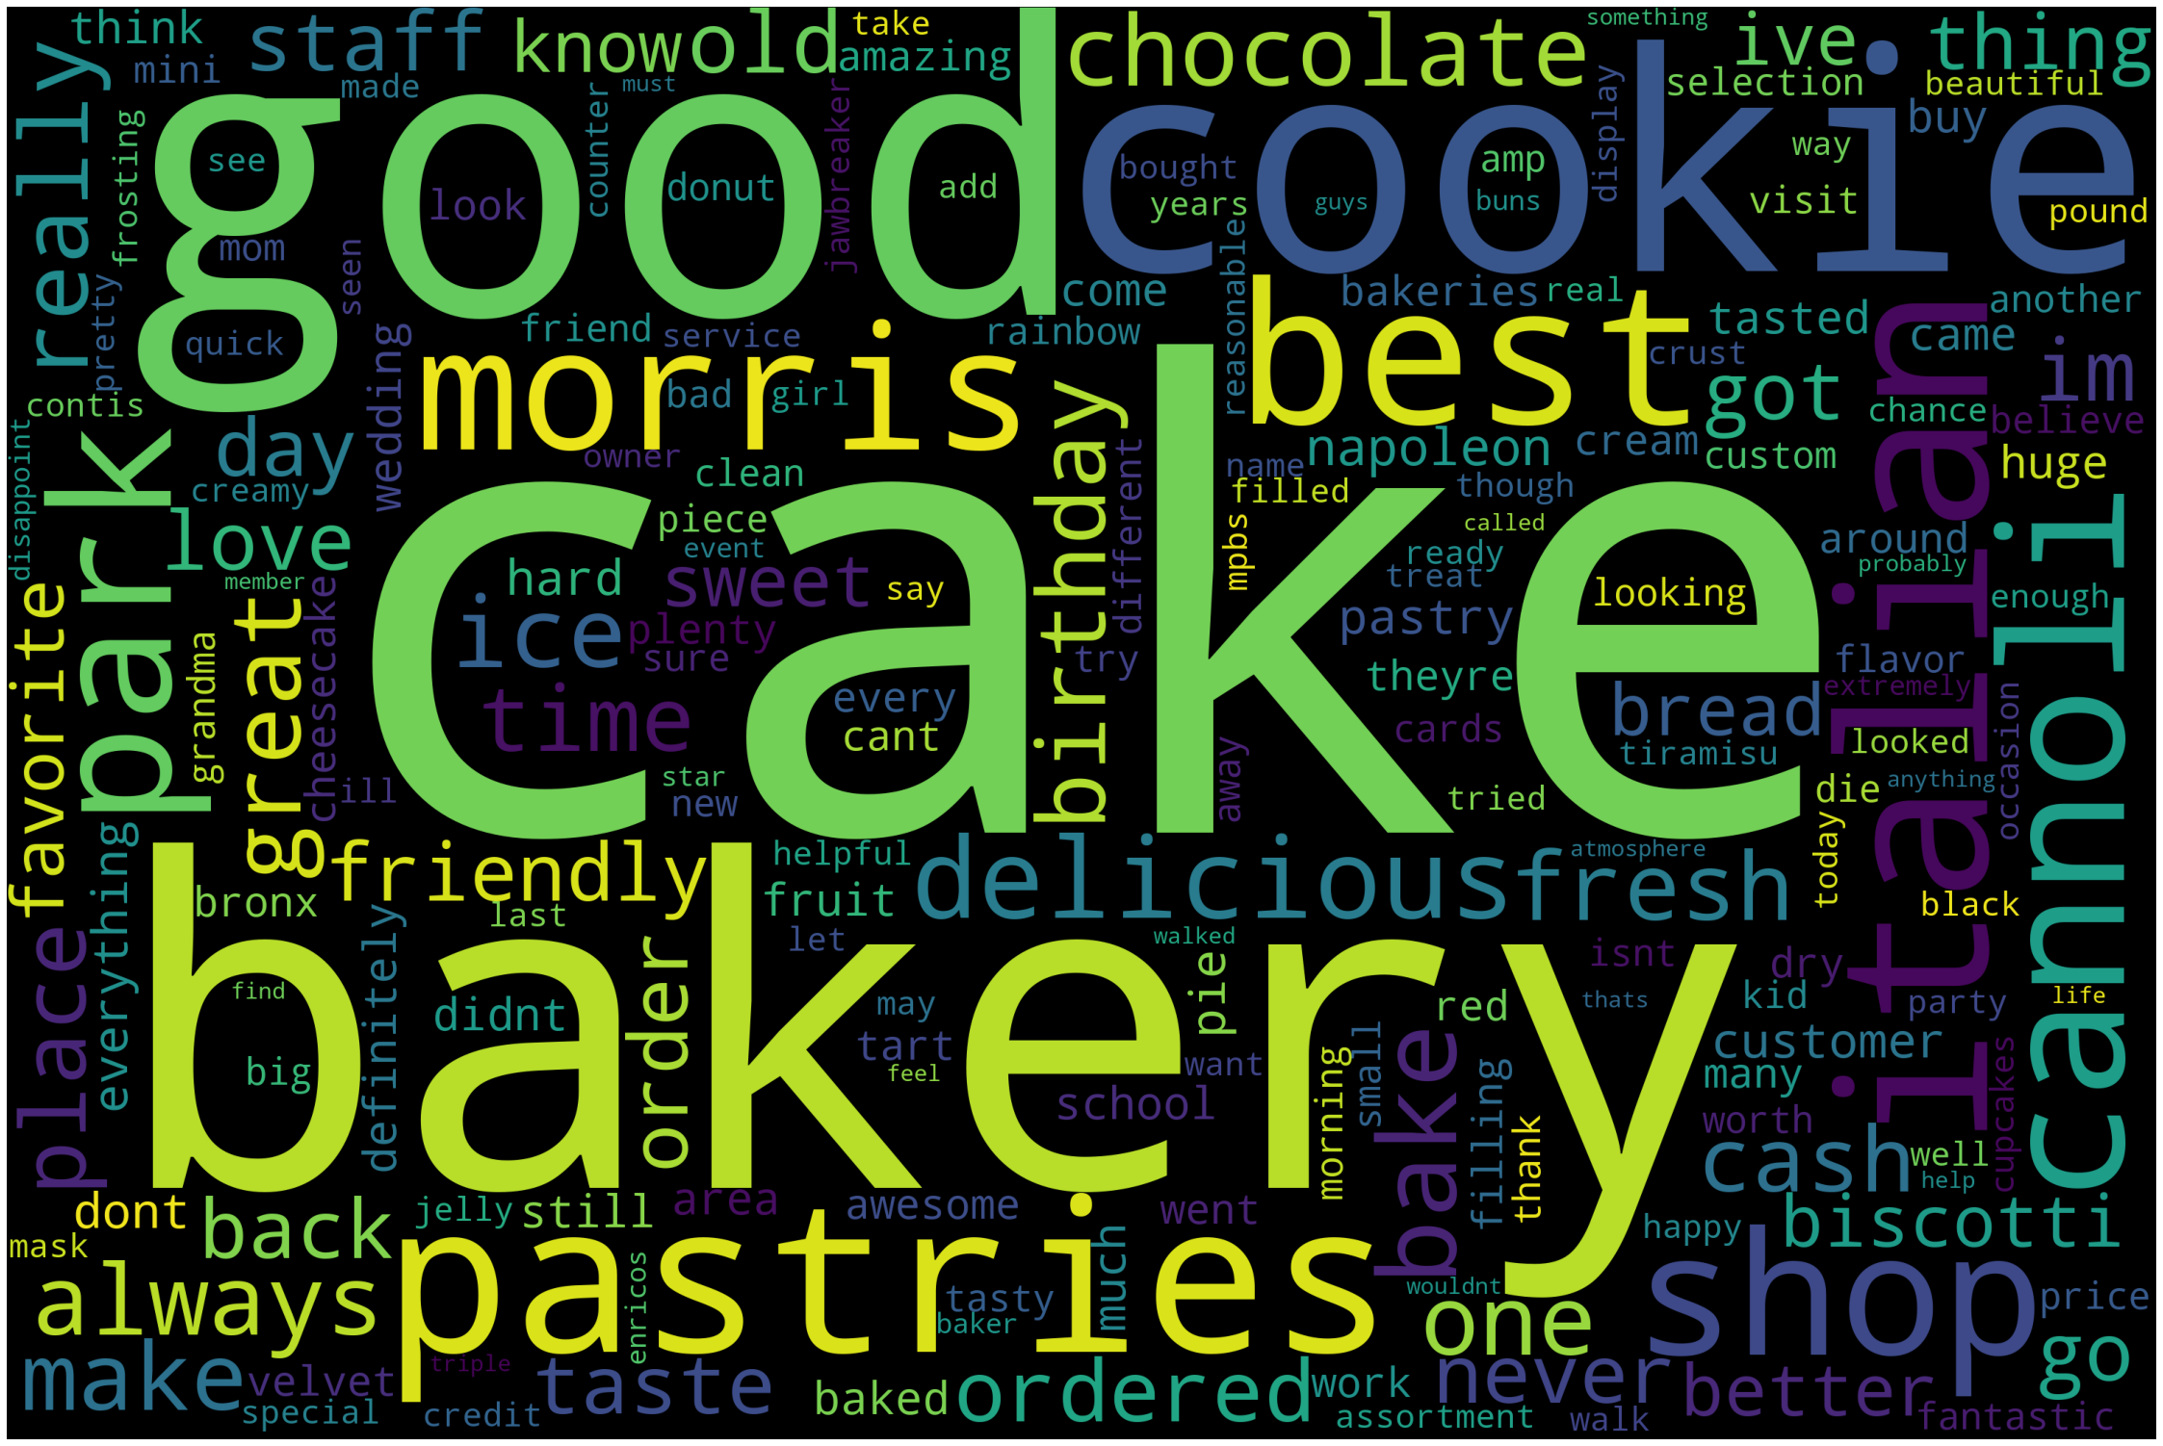
- We also built a word cloud based on which yelp could suggest what the popular products are for different establishments to first time customers.

Slide 10
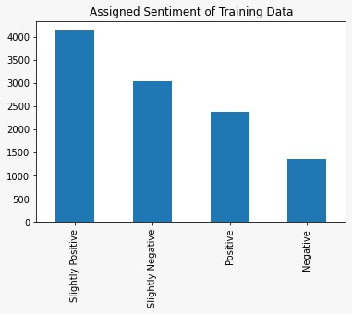
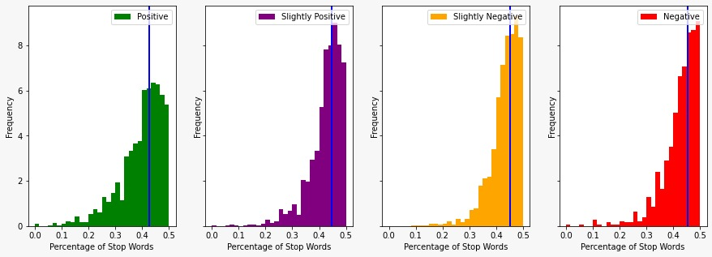
Data Analysis

Slide 11
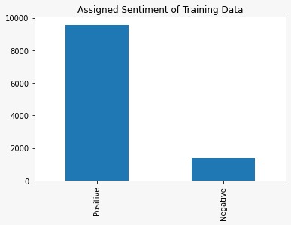
Data Analysis
- Based on model, most reviews received a positive sentiment rating

Slide 12

Machine Learning
This Photo by Unknown author is licensed under CC BY.

Slide 13
Machine Learning
- The learning model was built on assigned sentiments namely – Positive, Negative, Slightly Positive and Slightly Negative.
- To build a mathematical model for the textual data, vectorization was used to convert each word on the data set to a numerical representation using a sparse matrix.
- The model used for testing and training the text data for sentiment analysis is Logistic Regression.
- A random train test split of 7:3 ratio was used with cross validation, meaning 70 percent of the records in the data set was used to train the model and the remaining 30 percent was used to test it.

Slide 14

Conclusion
- Obtained accuracy of 67% rating by restaurant based on review attributes
- With positive and negative predictions having the highest accuracy of 92 and 87 percent respectively.
- To achieve better accuracy, we could train the model more and determine better criteria for what makes a review "slightly positive" or "slightly negative"

